Slide 1




Slide 2
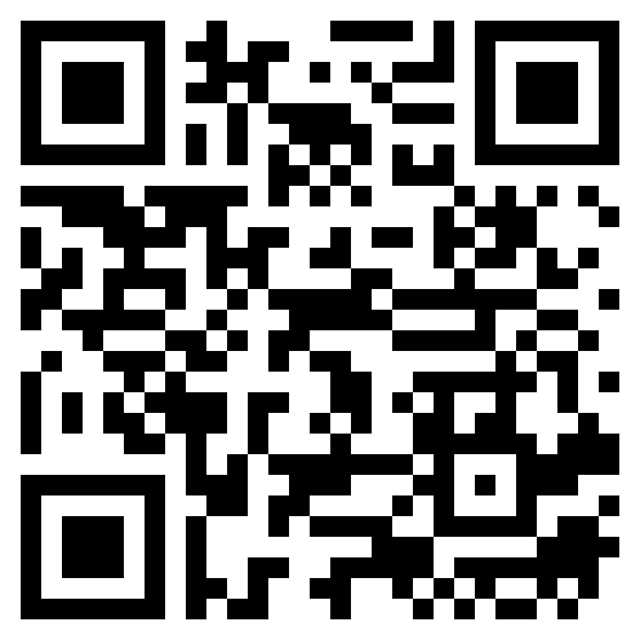
TEST TIME ON RESUME 2
URL: https://forms.gle/feFgLdSfQLjA2GCX9
QR CODE:

Slide 3

INTERVIEW SKILLS-1

Slide 4

What are interviewing skills?
Notes:
Interviewing skills are your ability to interact with the employer or interviewer and show them why you are the best-fit candidate for the job role. Your interview skills give an interviewer insight into how you will communicate in the workplace and solve problems. It also shows if you can actively listen and be honest in your work. All these factors tell your potential employers how well you will fit in their work environment.
During your interview, the employer may pay attention to your answers and the non-verbal cues you use while answering questions. For example, if you tap your foot while talking, it may show that you are nervous. So, this skill set helps you highlight the best features that can differentiate you from other candidates with similar qualification and work experience.

Slide 5

Why are interviewing skills important?
Notes:
Interview skills are important because they give your potential employer confidence that you can perform the job duties and accomplish your daily goals. Additionally, the skills you showcase during your interview help an employer determine and validate if your qualifications, experience and personality meet their requirements. For example, an employer may prefer interview skills like excellent verbal communication and confidence when hiring for a customer service representative role, as the job role requires a candidate to communicate confidently with their customers.

Slide 6

What is the most important skill for an interview?
Notes:
The most important skill for an interview is verbal communication because it helps you convey valuable information about your education, abilities and experience to a potential employer. Excellent verbal communication skills can help you deliver a well-thought-out answer that can increase your chances of getting hired.

Slide 7

Examples of interview skills
Notes:
An interview provides you with an opportunity to show the interviewer the soft skills you have that will make you a valuable asset to their company. Here are a few examples of skills you can use during an interview:

Slide 8

Research capabilities
Notes:
Good research capabilities help you perform well in an interview. For instance, you can read and analyse the job description and customise your resume based on that research. You should also do your research on the company you are interviewing for. That way, when the interviewer asks you questions like "Why do you want to work for this company?", you will be able to provide an informed answer that shows the employer you are the best-fit candidate for their organisation and its culture.
As part of your research, you can visit the company website, read the latest news about the company and talk to some of their employees.

Slide 9

Interview questions preparation
Notes:
Some basic interview questions are fundamental to almost every job role. It is always a good idea to practise such questions before facing your potential employers. Preparing beforehand for questions like "Tell me about yourself", "Why should we hire you?", "What are your greatest weaknesses?" or "Do you have any questions?" is an important interview skill, as it shows your attitude and seriousness about the job role. If you are applying for a technical role, make a list of commonly asked technical questions for that job role and practise them.
The more you practise, the better answers you can provide during the interview. Moreover, craft your own answers instead of copying and pasting generic answers from the Internet.

Slide 10

Verbal communication
Notes:
During an interview, employers may pay close attention to your tone and pitch. They want to see if you can communicate your ideas clearly and cohesively. Talking too fast can make you look anxious. It also prevents you from conveying your message clearly. The ability to speak calmly to make sure that others can understand you is a skill that you can develop through practice.

Slide 11

Non-verbal communication
Notes:
From the moment you walk into the interview room, employers will pay close attention to the non-verbal cues you portray. Non-verbal communication includes body language, posture, gestures, facial expression and eye contact. For example, if you sit with crossed legs or arms during the interview, it shows that you are nervous and anxious. Being able to maintain eye contact and have a smile on your face is important in order to succeed in an interview.

Slide 12

Time management
Notes:
Time-management skills are important because they show that you can plan, prepare and organise your time. You should reach the interview venue at least 10 to 15 minutes ahead of time and keep track of the time you spend answering each question. Also, before coming for the interview, plan your mode and route of travel to be punctual. It is always good to keep some buffer time in case you encounter heavy traffic or a flat tyre.

Slide 13

Confidence
Notes:
Self-confidence is the ability to stay confident in your skills and abilities. This is an essential skill because it shows that you have trust in yourself. To showcase a confident attitude during the interview, control your fidgeting, greet the employer with a handshake, talk slowly and maintain eye contact. Also, when you answer the interview questions confidently during an interview, it helps make the interviewer feel more confident about your skills, experience and knowledge.

Slide 14
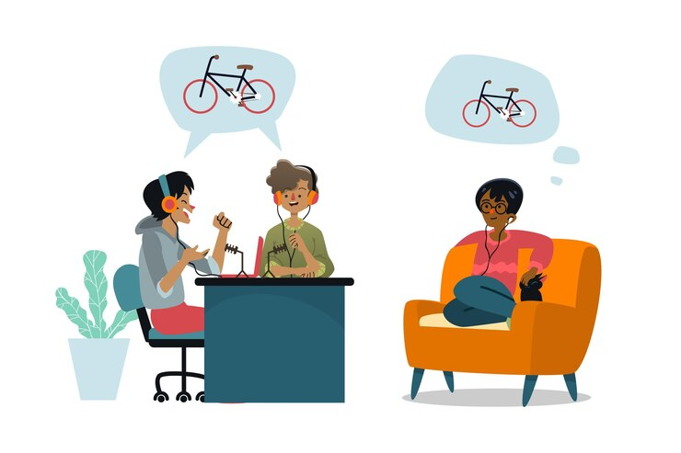
Active listening
Notes:
Active listening is as important as answering the job interview questions. If you listen properly to the employer's question, you will be able to understand what exactly they are looking for and craft your answers accordingly. It also shows that you are engaged and serious about the job role. For example, when an employer asks you, "Do you have any questions?" instead of asking generic questions, ask questions based on your conversation with the employer. This can increase your chances of getting hired.

Slide 15

Positive attitude
Notes:
Having a positive attitude during an interview can influence the hiring decision in your favour. For example, when asked about why you left your previous job, saying negative things about your previous employers is not a good way to answer such questions. So, focus on giving optimistic reasons for leaving a previous job. You can also show your positive attitude using active verbs and positive connotations to present your qualifications favourably to the employers.

Slide 16

Politeness
Notes:
Being polite is another critical interview skill. Apart from the employer, you are likely to meet several company employees during the interview process. For example, you may interact with the receptionist, so greet and talk to them politely. Also, if a human resources professional escorts you to the interview room, remember to thank them. It is imperative to be friendly and polite to everyone, as it shows how well you can fit in the organisation and work with others.

Slide 17

Honesty
Notes:
One skill that makes you a desirable candidate for a job role is honesty. To show your honesty during the interview process, make sure that all the information you provide about yourself is correct. As most employers perform a background check on their new hires, there is no point in exaggerating about your experience, skills and qualifications.
For example, if you have mentioned in your resume that you are fluent in Spanish, be ready to demonstrate your skills in the interview. It is always advisable to write nothing but the truth on your resume. Being honest can help you gain the trust of the employer.

Slide 18
What are the 5 top interview techniques?
Make a good first impression.
Dress appropriately.
Improve your interview skills.
Use the STAR technique to answer questions.
Express gratitude after the interview.

Slide 19

What is the STAR method when interviewing?
Notes:
The STAR interview response technique helps a candidate prepare for behavioural and situational interview questions. STAR stands for situation, task, action and result. With this technique, you can use real-life examples to give clear and concise answers.

Slide 20
When using the STAR technique, formulate your answer using the following steps:
Explain a challenge or situation you faced.
Describe your responsibility or role in the situation of challenge.
Explain what actions you took to solve the problem.
Give details about the outcome you reached with your actions.

Slide 21
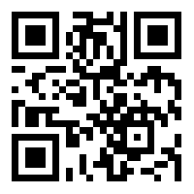
https://learn.codemithra.com

Slide 22




THANK YOU
+91 78150 95095
codemithra@ethnus.com
www.codemithra.com

